Slide 1
Android
Android Developer Fundamentals
Lesson 1

Slide 2
Views

Slide 3
Views
The View class is the basic class that all the components extend
A View draws something on a piece of screen and it is responsible to handle events while user interacts with it.
A ViewGroup is a special View that holds other views and places these views following some rules

Slide 4
Views features
Properties: These properties affect the way the view is rendered. (common to all views, depending on the type).
Focus: The system manages the focus on each view and depending on the user input
Listeners: All views have listeners which are used to handle events when the user interacts with the view.
Visibility: We can control if a view is visible or not and we can change the view visibility at runtime too.

Slide 5
Setting property
We have two ways to do it:
using XML while we deﬁne our view
programmatically

Slide 6
In XML
For example, let’s suppose we want to deﬁne a TextView
<TextView
android:id="@+id/textView1" android:layout_width="wrap_content" android:layout_height="wrap_content" android:text="@string/hello_world" />

Slide 7
In Java
TextView tv = new TextView(this);
tv.setText(“Hello World");
Both XML and Java have same effect.
however, the ﬁrst one is the preferred one

Slide 8
properties
Two properties that play an important role are layout_width and layout_height.
We can use two predeﬁned values:
• MATCH_PARENT • WRAP_CONTENT
With MATCH_PARENT value, view is big as its parent to hold it, while with WRAP_CONTENT, view must be big enough to hold its content.
There is another option: using a numeric value. In this case, we specify the exact measure of our view.

Slide 9
Listeners
The Android SDK has several listener types, so different interfaces can be implemented.
Two of the most popular are: View. OnClickListener, View.OnTouchListener

Slide 10
Textview other properties
<TextView
android:id="@+id/textView1"
android:layout_width="wrap_content"
android:layout_height="wrap_content"
android:text="@string/hello_world" />
where android:text holds the text we want to show
• android:fontFamily - It is the font-family
. • android:shadowColor - It is the shadow color.
• android:shadowDx - It is the shadow x axis offset.
• android:shadowDy - It is the shadow y axis offset.
• android:textStyle - It is the style (bold, italic, bolditalic).
• android:textSize - It is the text size.

Slide 11
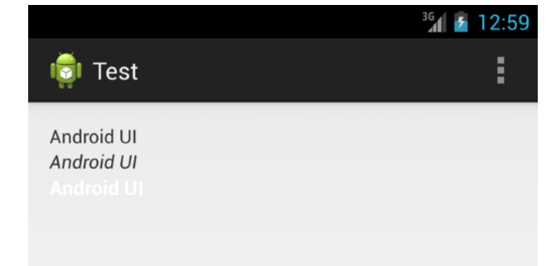
Example
<TextView
android:id="@+id/textView1"
android:layout_width="wrap_content"
android:layout_height="wrap_content"
android:text="Android UI" />
<TextView
android:id="@+id/textView2"
android:layout_width="wrap_content"
android:layout_height="wrap_content"
android:text="Android UI"
android:textStyle="italic" />
<TextView
android:id="@+id/textView2"
android:layout_width="wrap_content“
android:layout_height="wrap_content“
android:text="Android UI" android:textColor="#FFFFFF" android:textSize="15dp" android:textStyle="bold" />

Slide 12
ImageView component
This component is used to show an image on the screen.
In the ﬁrst case, our image has to be placed under the res/drawable directory
To support multiple device compatibility five folders will be there in IDE. Copy the image in all.
the images must have the same name in all folders.
drawable-ldpi (not supported any more)
drawable-mdpi (medium dpi)
drawable-hdpi (high dpi)
drawable-xhdpi (extra-high dpi)
drawable-xxhdpi (x-extra-high dpi)
drawable

Slide 13

Usage of imageview
<ImageView
android:id="@+id/img“
android:layout_width="wrap_content“
android:layout_height="wrap_content“
android:src="@drawable/robot" />

Slide 14
Input controls
Input controls are components that the user can interact with.
text field, input field, toggle buttons, radio buttons, buttons, checkbox, pickers and so on

Slide 15
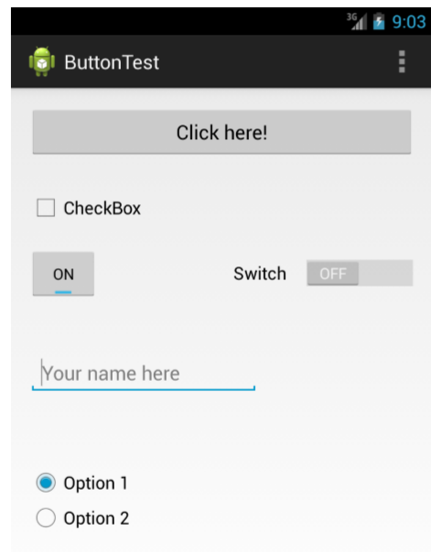
Design this
Insert
Button
Checkbox
Toggle button
Switch
editText
Radio button

Slide 16
What's Next?
Events

Slide 17
END

